Slide 1
Databases
Introduction to databases
Notes:
1
20483C
1: Review of Visual C# Syntax

Slide 2
Intro
What is a database?
Notes:
2
20483C
1: Review of Visual C# Syntax

Slide 3
Intro
What is a database?
An organized collection of data that is saved
and can be retrieved from a database management system
Notes:
3
20483C
1: Review of Visual C# Syntax

Slide 4
Intro
RDBMS
Relational DataBase Management System
Notes:
Microsoft SQL Server is a DataBase Management System (DBMS). It's a program you install on your computer. Specifically its a RDBMS. The "R" stands för Relational.
4
20483C
1: Review of Visual C# Syntax

Slide 5
Intro
Microsoft SQL Server
Microsoft SQL Server Management Studio
Microsoft SQL Database
Notes:
In the RDBMS you can create serveral Microsoft SQL Databases. On your computer you can have 100's of databases.
To make it easy to do task (e.g create databases, get info, change info) you use a program. We'll use Microsoft SQL Server Management Studio 18. This is also used to give a visual view of the databases and their design.
Other examples of RDBMS's:
Oracle Database
MySQL
IBM DB2
5
20483C
1: Review of Visual C# Syntax

Slide 6
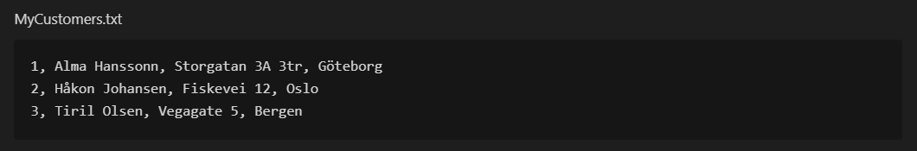
Intro
Why a database?
Why not simple textfile?
Notes:
When building a webbapp, game, homepage, mobilapp you will in 90% of the time need some way to store information.
E.g for a game you would save player accounts, highscores, player profiles etc.
If you create a webbapp for a bank, you probaly need to store information about a customer. You have a bank with three customers. One way of storing this information is using av simple textfile (txt) like this:
What's the problem with the solution above? [DISCUSSION]
6
20483C
1: Review of Visual C# Syntax

Slide 7
Intro
Solidity
Standard
Security
Performance
Notes:
Reasons to use a database
Solidity
- What happens to the textfile if the power is turned off during a update? Probably information will be lost or worse: part of the information will be lost.
- Transactions: so you can make serveral changes to the data and be sure that all will be done (or no of the instruction if something unpredicted happens)
- Limitations: You can setup limitation to the data so the will be no garbage in the database + the data is interconnected
Standard
- You use a standard way to store data (a standard languge, SQL)
- You use a standard way to retreive and change data
Security
- Rights: You can setup account so different people have different rights
Performance
- You can handle a lot of data in a fast way (reading and updating)
7
20483C
1: Review of Visual C# Syntax

Slide 8
Intro
ACID
Notes:
In computer science, ACID (atomicity, consistency, isolation, durability) is a set of properties of database transactions intended to guarantee validity even in the event of errors, power failures, etc.
In the context of databases, a sequence of database operations that satisfies the ACID properties (and these can be perceived as a single logical operation on the data) is called a transaction. For example, a transfer of funds from one bank account to another, even involving multiple changes such as debiting one account and crediting another, is a single transaction.
In 1983, Andreas Reuter and Theo Härder coined the acronym ACID as shorthand for atomicity, consistency, isolation, and durability, building on earlier work by Jim Gray who enumerated atomicity, consistency, and durability but left out Isolation when characterizing the transaction concept. These four properties describe the major guarantees of the transaction paradigm, which has influenced many aspects of development in database systems.
8
20483C
1: Review of Visual C# Syntax

Slide 9
Intro
Atomicity
Consistency
Isolation
Durability
Notes:
Atomicity: Guarantees that each transaction is treated as a single "unit", which either succeeds completely, or fails completely. E.g: transfer money between two bank account (if it fails you want every step to rollback)
Consistency: Any data written to the database must be valid according to all defined rules, including constraints, cascades, triggers, and any combination thereof. E.g two person could not have the same ID.
Isolation: Ensures that concurrent execution of transactions leaves the database in the same state that would have been obtained if the transactions were executed sequentially. Multiple transactions may be executed partly at the same time (for performance reasons). But isolation makes the end result be the same as if they were executed in sequence. E.g if you send money from two bank account there are multiple transactions to be done. Isolation ensures that the transactions dont collide.
Durability: Durability guarantees that once a transaction has been committed, it will remain committed even in the case of a system failure (e.g., power outage or crash). E.g a transcation is completed and the power went of. When the computer and database is up and running again the database has remembered the transaction.
9
20483C
1: Review of Visual C# Syntax

Slide 10
Intro
SQL
Notes:
SQL is a standardised computer language. It have commands for saving, changing and retreiving data in databases.
SQL = Structured Query Language
If you use a relation database (which we are), then SQL is the standard way to communicate.
SQL was developed during the 70’s. Standardized during the 80’s
SQL Server 1.0. From 1989
10
20483C
1: Review of Visual C# Syntax

Slide 11
Intro
SQL
What can you do?
Notes:
With SQL you can:
Retreive data from a database
Add data
Modify data
Remove data
Futher more:
Create new databases
Create tables
Create stored procedures
Create views
Give access
11
20483C
1: Review of Visual C# Syntax

Slide 12
Intro
SQL
A standard
Notes:
SQL is a standard but diffent companies make their own version and there are (small) differences. So the syntax can be a bit different (but 95% are the same)
Example of other relational databases:
SQL Server
MySQL
Oracle
Sybase
PostgreSQL
12
20483C
1: Review of Visual C# Syntax

Slide 13
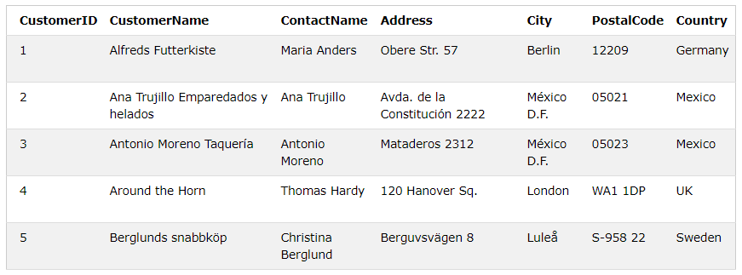
Intro
Notes:
A table is a collection av related data. It is composed of columns and rows.
A table is the way you store info in a database
The columns is called fields. The field in the customer table above are: CustomerID, CustomerName, ContactName, Address, City, PostalCode and Country.
A record is the same as a row in a table.
13
20483C
1: Review of Visual C# Syntax

Slide 14
Intro
int
decimal
varchar(50)
datetime
Notes:
A field has a certain datatype. In a field you can store:
A number
A string or a character
Date
Binary data
Example of datatypes are: int, decimal, varchar(50), datetime
14
20483C
1: Review of Visual C# Syntax

Slide 15
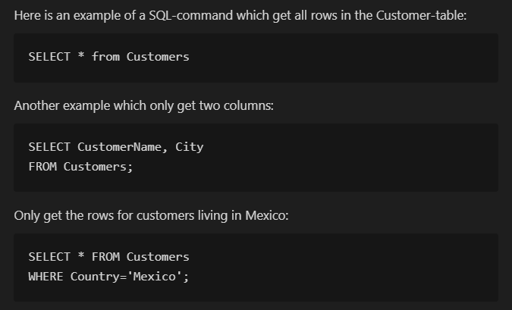
Intro
Notes:
15
20483C
1: Review of Visual C# Syntax

Slide 16
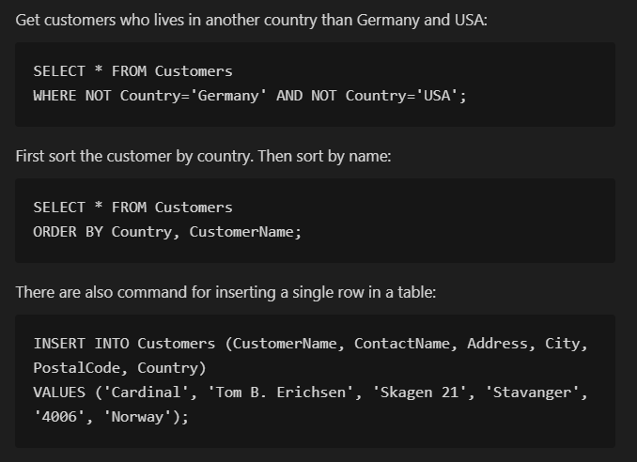
Intro
Notes:
16
20483C
1: Review of Visual C# Syntax

Slide 17
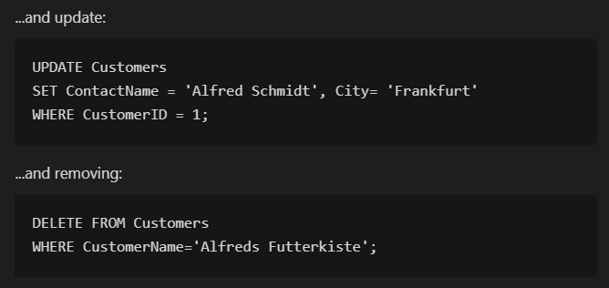
Intro
Notes:
17
20483C
1: Review of Visual C# Syntax

Slide 18
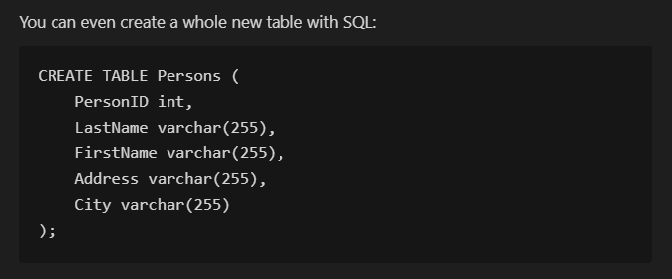
Intro
Notes:
18
20483C
1: Review of Visual C# Syntax

Slide 19
Intro
Data Definition Language
Data Manipulation Language
Transaction Control Language
Data Control Language
Notes:
There are four parts of SQL:
DDL - build database
DML - get data
TCL - commit transactions
DCL - manage access
19
20483C
1: Review of Visual C# Syntax

Slide 20
Intro
Data Definition Language
Notes:
Data Definition Language is used to define the database structure or schema.
Commands for building the structure
DDL statements is used to create and modify database objects such as tables, indexes, and users.
20
20483C
1: Review of Visual C# Syntax

Slide 21
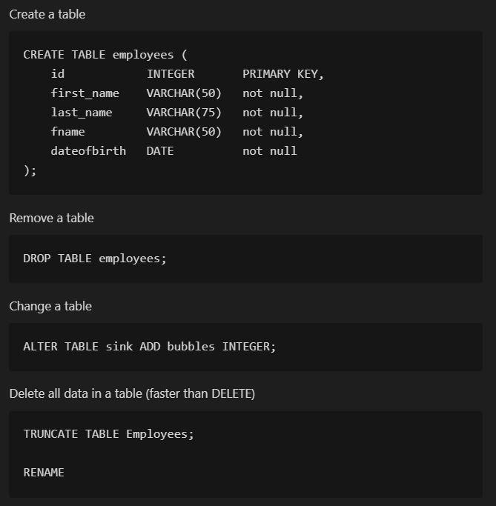
Intro
Data Definition Language
Notes:
Data Definition Language is used to define the database structure or schema.
DDL statements is used to create and modify database objects such as tables, indexes, and users.
21
20483C
1: Review of Visual C# Syntax

Slide 22
Intro
Data Manipulation Language
Notes:
DML (Data Manipulation Language) statements are used for managing data with in schema objects.
Get rows in a table
Insert rows in a table
Modify and delete
22
20483C
1: Review of Visual C# Syntax

Slide 23

Intro
Data Manipulation Language
Notes:
DML (Data Manipulation Language) statements are used for managing data with in schema objects.
23
20483C
1: Review of Visual C# Syntax

Slide 24
Intro
Transaction Control Language
Notes:
Transaction Control Language commands are used to manage transactions in the database
24
20483C
1: Review of Visual C# Syntax

Slide 25

Intro
Transaction Control Language
Notes:
Transaction Control Language commands are used to manage transactions in the database
Manage multiple DML statements
25
20483C
1: Review of Visual C# Syntax

Slide 26
Intro
Data Control Language
Notes:
A Data Control Language is used to control access to data stored in a database (Authorization).
26
20483C
1: Review of Visual C# Syntax

Slide 27

Intro
Data Control Language
Notes:
A Data Control Language is used to control access to data stored in a database (Authorization).
27
20483C
1: Review of Visual C# Syntax

